Slide 1
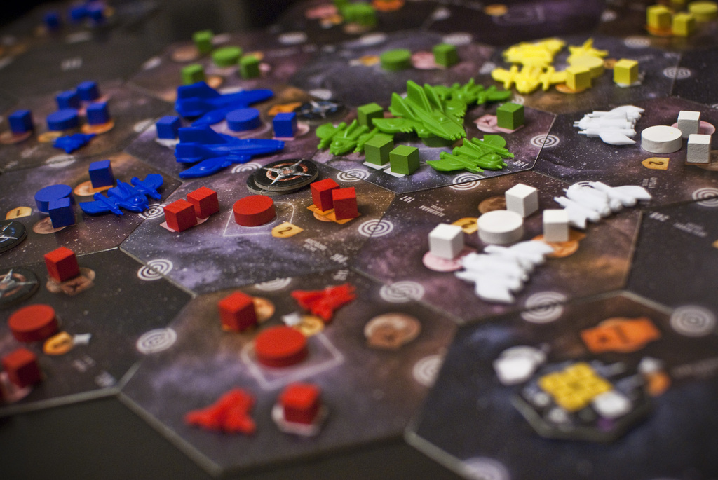
The Data Science of Board Games
Scott Burger
Data Scientist, Microsoft

Slide 2

This talk
Intro to modern board games
The BoardGameGeek database
Top dogs and bottom feeders
Measuring the ‘most popular’ games
Ratings and game ‘behaviors’
Designing a way to measure board game balance

Slide 3

About me
University College, London - Astrophysics
Data Scientist - Microsoft
Race bikes on the Seattle Cancer Care Alliance cycling team
Writing book on machine learning (2018)
Like games of all kinds (digital, analog)
Blog about it all on svburger.com

Slide 4

What is data science?
Catch-all for scientific approaches to using data to solve questions
90% just data manipulation problems
4% statistics
4% machine learning
2% other
Typical tools: SQL, Python, R, Excel
Tools used here: R (code online)

Slide 5
The Gateway
Risk, Stratego having to compete with prime SNES and N64 games
Had played games like Life, Sorry!, Mousetrap, Battleship, but never really ‘hooked’
Until that is… Power Grid
Showed that games could be difficult, different, deterministic
So what defines a ‘gateway’ game exactly?
Rough criteria: simple to learn, well-rated

Slide 6
Why Board Games?
The number of board game releases has seen an explosive growth in the past few years
Games released since 2006 account for 52% of all board games made since 1950
Big advancements in the different types of games developed (kickstarter, legacy games)
Explosion in popularity reflected in social sites like reddit

Slide 7
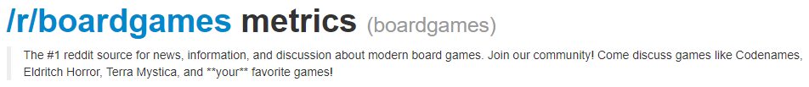
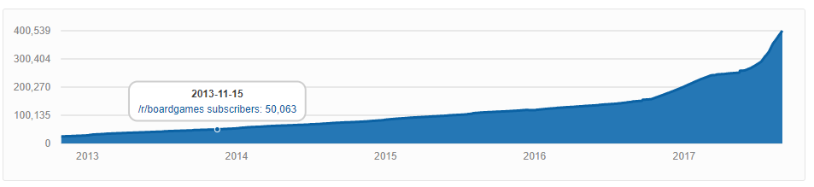

Slide 8

Why BoardGameGeek.com?
Huge amount of data: over 500k items (games, expansions, other stuff)
Lots of great info from player ratings, number of plays, game complexity, if a game is recommended for certain numbers of players
Enthusiast community keeps the database on the cutting edge
Cons: enthusiast community biased towards hottest new releases, rating skewness, your favorite game might not be their favorite game, lots of noise in the dataset that needs to be cleaned out

Slide 9
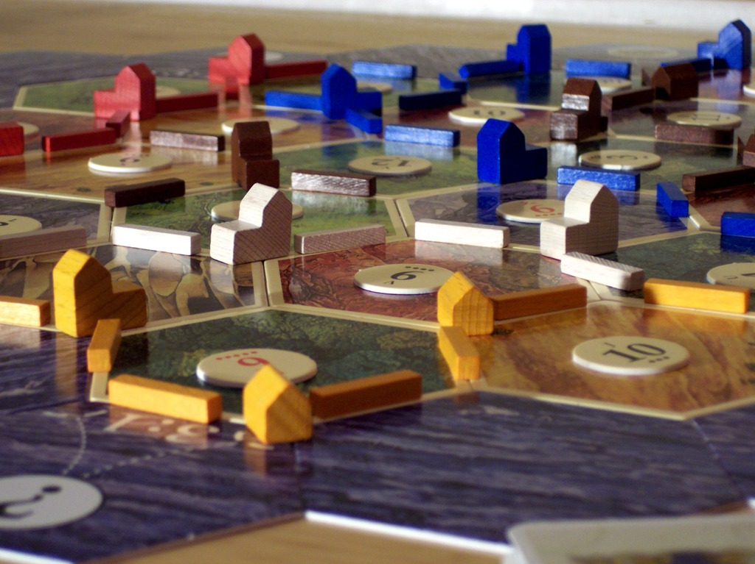
The Top Dogs and Bottom Feeders

Slide 10
What are the most popular games?
Games with the highest number of ratings show the current landscape of what’s been consistently the most popular
Issue: very long tailed dataset
name | numratings
Catan | 70244
Carcassonne | 69861
Pandemic | 65664
Dominion | 57924
7 Wonders | 54428
Ticket to Ride | 50233
Agricola | 49704
Puerto Rico | 49181
Small World | 44925

Slide 11
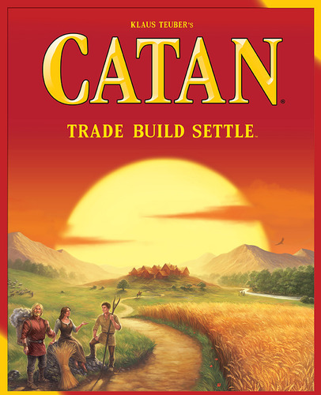
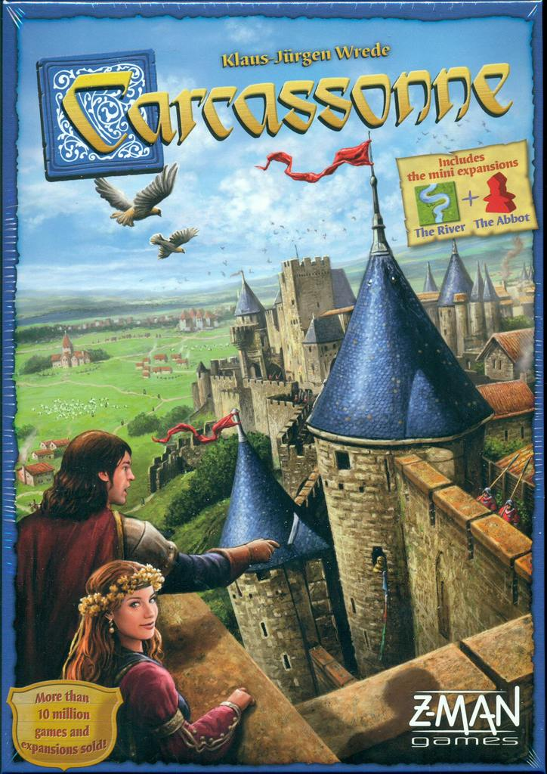

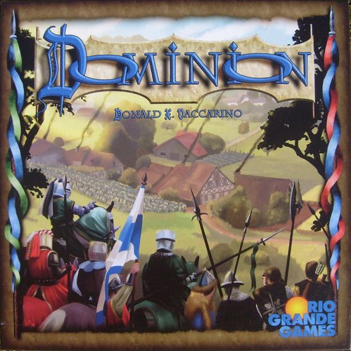

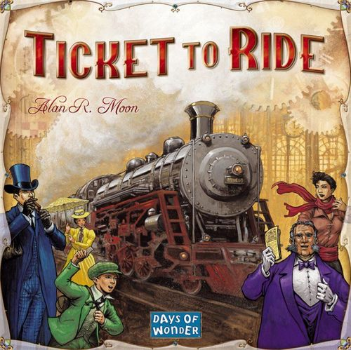
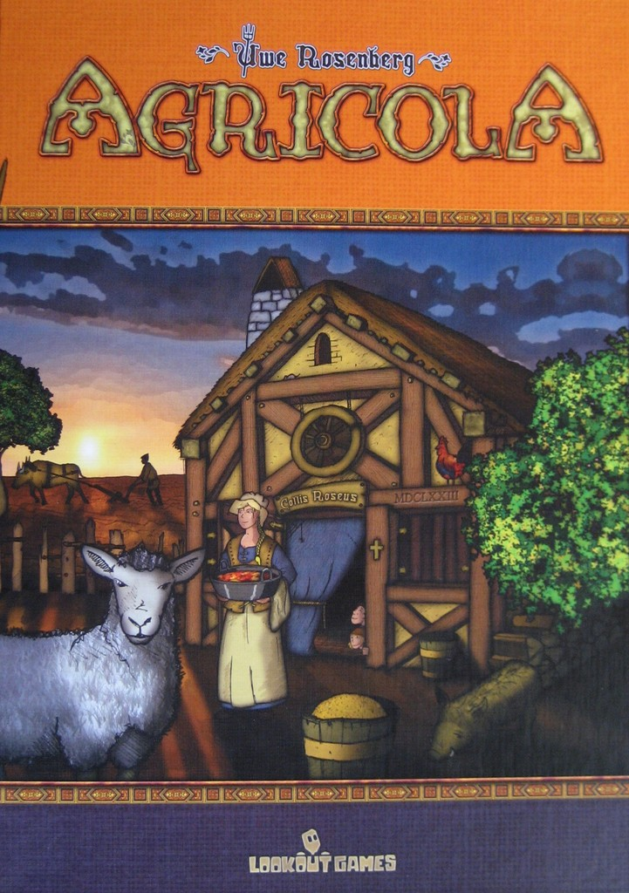

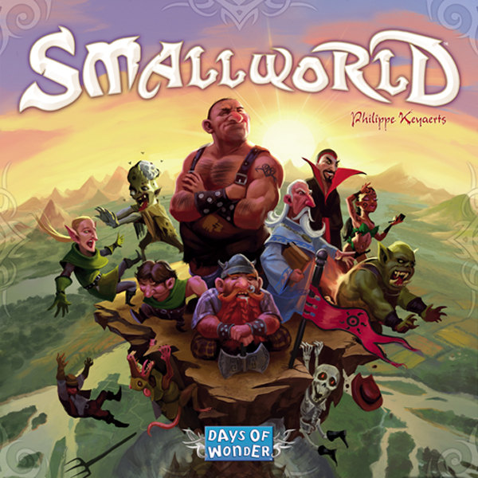

Top 10 by number of ratings
Catan | 70244
Carcassonne | 69861
Pandemic | 65664
Dominion | 57924
7 Wonders | 54428
Ticket to Ride | 50233
Agricola | 49704
Puerto Rico | 49181
Small World | 44925
Power Grid | 43295
65664
57924
54428
70244
69861
50233
49704
44925
49181
43295
Notes:
(Settlers of) Catan: game of rolling dice and buying resources on a randomized hexagonal tile board
Carcassonne: city building game where you score points by placing workers to do stuff for you
Pandemic: co-operative game of trying to fight a global outbreak of disease
Dominion: deck building game with a dizzying amount of customization
7 wonders: card drafting and empire building game based on ancient times
Ticket to Ride: simple, but highly competitive series of train route building games
Agricola: complex game of farming and survival
Small World: area control game with vast array of zany characters
Power Grid: complex-ish game of bidding to power cities

Slide 12

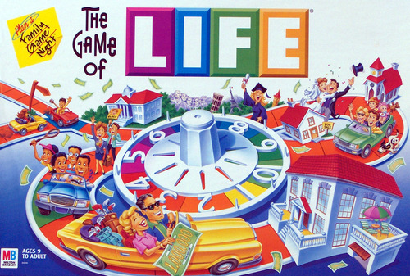
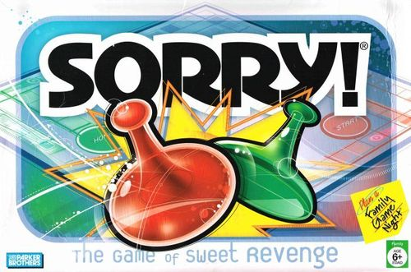
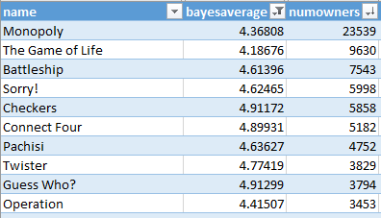
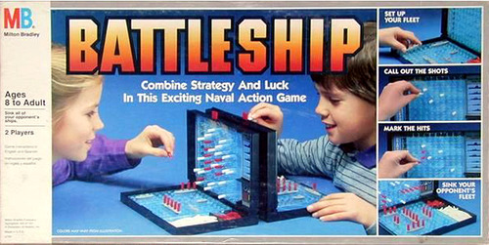
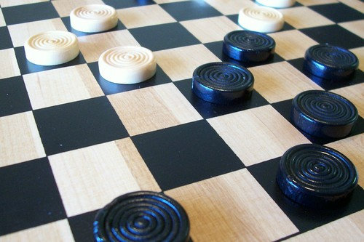


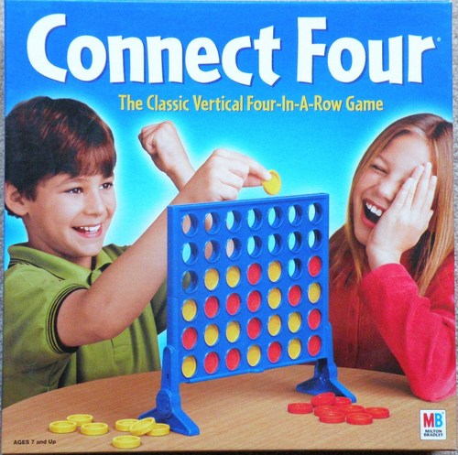
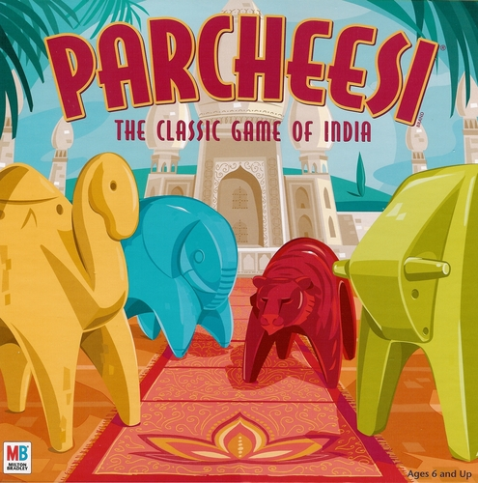
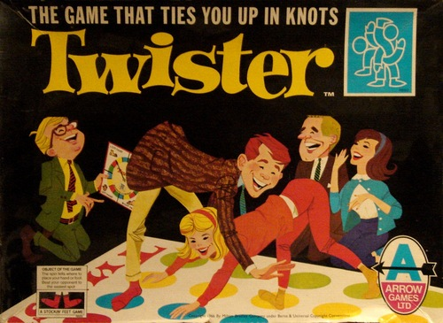
Top 10 owned games with ratings less than 5.0
9630
7543
5998
5858
23539
3829
3794
3453
5182
4752
Notes:
4: not so good, but would play again
3: bad. Likely wont play this again
Only 5 games have a bayes rating of 3 or lower: War, Bingo, Candy Land, Snakes and Ladders, and Tic-Tac-Toe

Slide 13
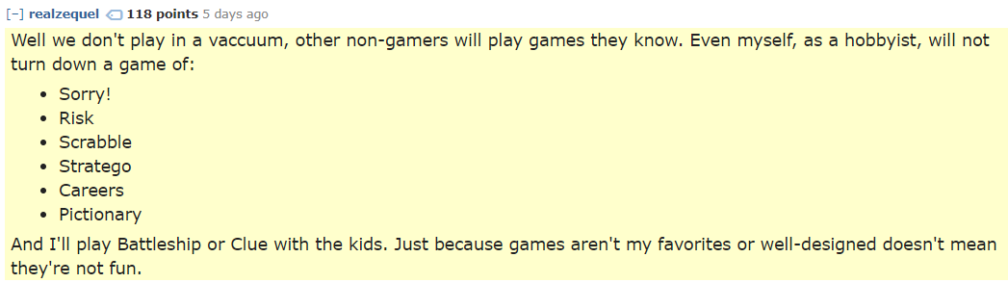

Slide 14
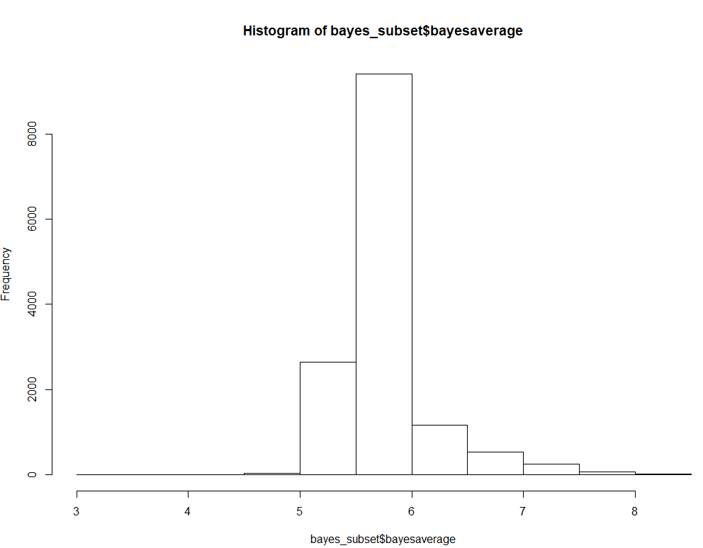
Caveats
BGG database is skewed heavily to enthusiasts and hobbyists at the top end
Global ratings are, surprisingly, well balanced!
“IGN effect”: a 7 rated game shouldn’t be thought of as ‘bad’
1: Awful – defies game description
2: Very bad – won’t ever play again
3: Bad – likely won’t play this again
4: Not so good – but could play again
5: Mediocre – take it or leave it
6: Ok – will play if in the mood
7: Good – usually willing to play
8: Very good – enjoy playing and would suggest it
9: Excellent – very much enjoy playing
10: Outstanding – will always enjoy playing

Slide 15
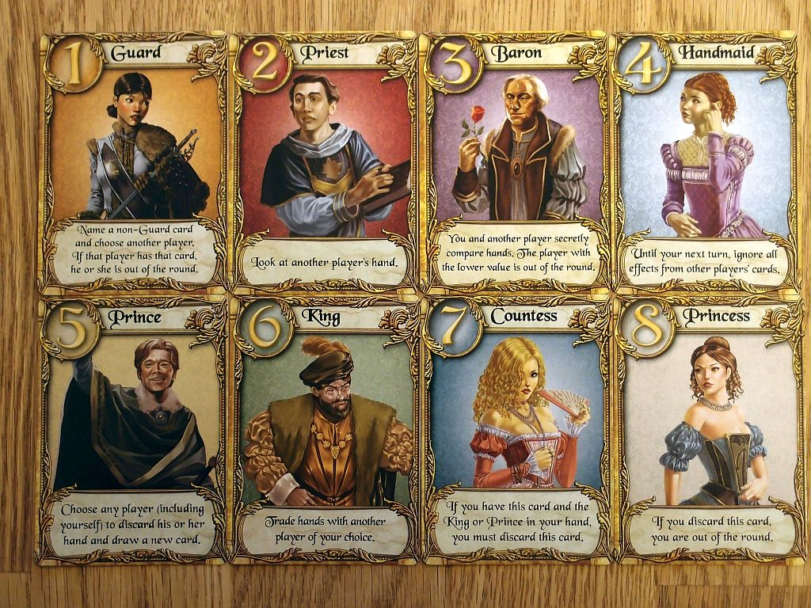
Games and Popularity

Slide 16





Measuring Popularity (top 10 by play count)
name | num_plays
Dominion | 311405
Race for the Galaxy | 232193
7 Wonders | 209112
Agricola | 164639
Love Letter | 135292
Ticket to Ride | 131778
King of Tokyo | 128340
Android: Netrunner | 121803
Catan | 118007
164639
232139
164639
311405
209112
135292
128340
131778
121803
118007
Notes:
Star realms 103730

Slide 17

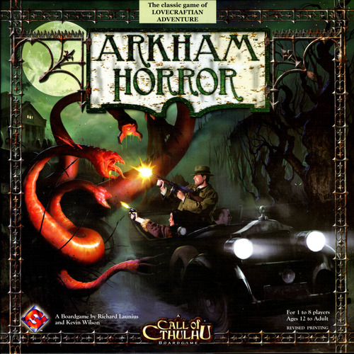
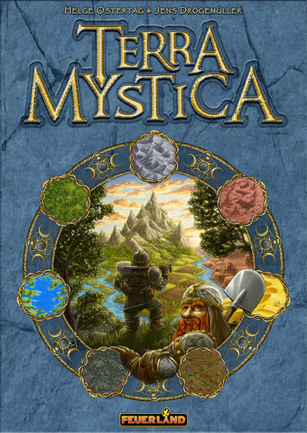


Measuring Popularity (top 10 by playtime hours)
321918
217780
Agricola | 164639 | 411597.5
Arkham Horror | 53653 | 321918
Catan | 118007 | 236014
Race for the Galaxy | 232193 | 232193
Through the Ages: A Story of Civilization | 54445 | 217780
Twilight Struggle | 61614 | 184842
Power Grid | 89886 | 179772
Terra Mystica | 68110 | 170275
Dominion | 311405 | 155702.5
Eldritch Horror | 38567 | 154268
236014
232193
411597
184842
154268
179772
115702
170275

Slide 18

Evolving Nature of Board Games

Slide 19
Genres over time
Type, category, mechanics since 1950
Genres are spotty before then
And for some reason after 2006???
The landscape has been mostly stable
Information overload with number of categories to choose from
Type: 8
Categories: 84
Mechanics: 52

Slide 20
Game Types By All Years

Slide 21
Game Types: 1950-2017 (stacked)

Slide 22
Top 20 Game Categories: 1950-2017 (stacked)

Slide 23
Top 10 Game Mechanics: 1950-2017 (stacked)

Slide 24
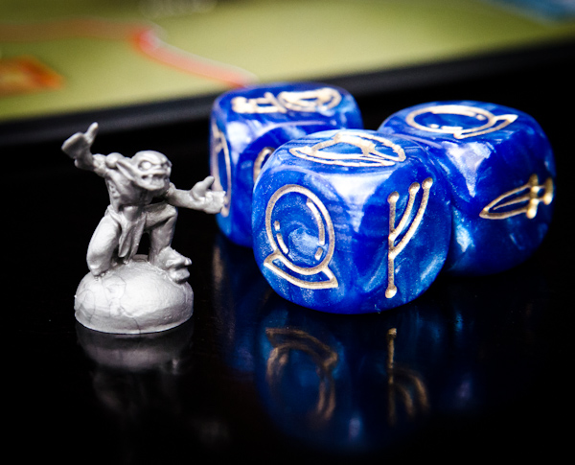
Modelling Ratings and Ownership

Slide 25
Game Modelling
How do we model the relationship between ratings and game length?
Visual: box plot, binned by game length in hours
Statistical: fit a curve and find the peak
Done with R and ggplot() package

Slide 26
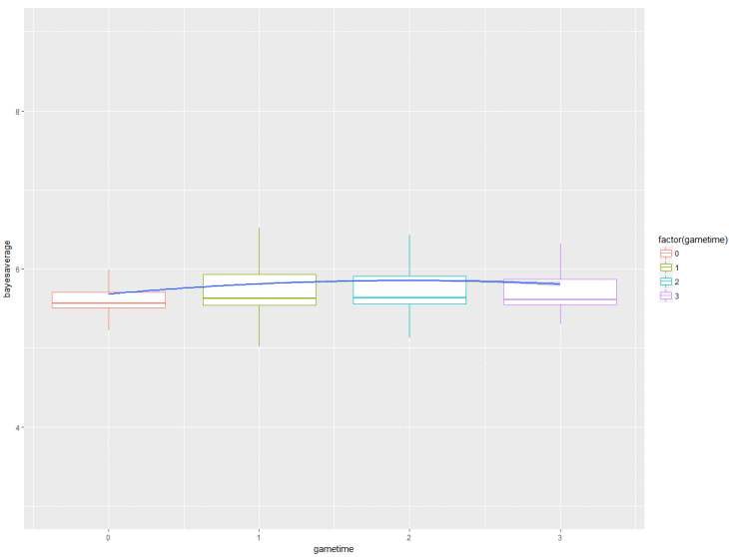
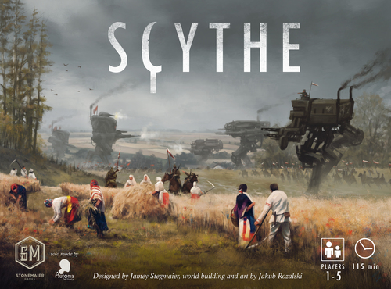



Rating as a function of playtime in hours
Games ratings peak at 1.987 hours

Slide 27
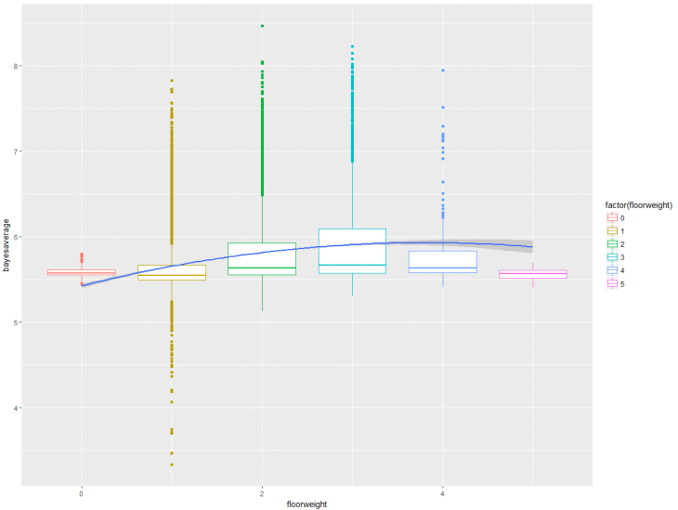

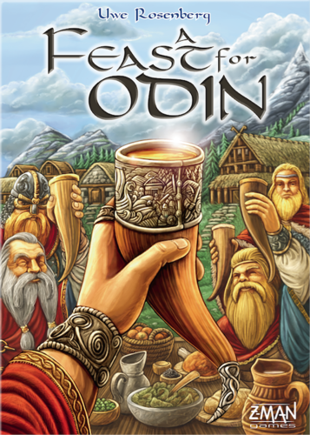

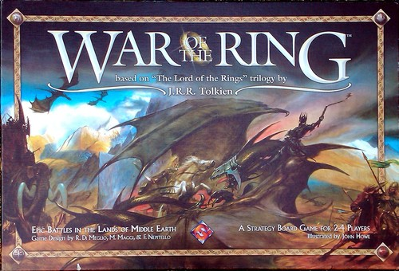
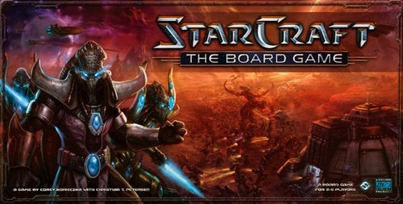
Rating as a function of game complexity
Rating vs complexity peaks at 3.8233

Slide 28
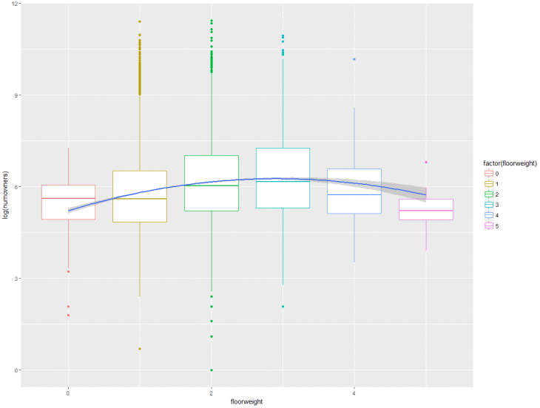





Number of owners as a function of game complexity
Peaks at 2.92

Slide 29
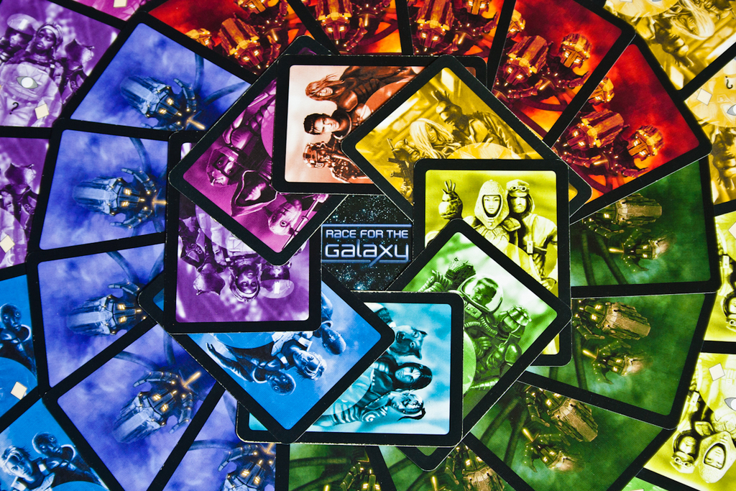
Games and Player Balance

Slide 30
Game balance
“What’s a game that plays better with more people?”
Flawed statement – regression could start at 0 and go up to 50% recommended at 8 players and have a wild growth to it
Reformulated question: “what’s a game that plays the best across all the players that its capable of supporting?”
How do we define game balance?

Slide 31
Game balance
Easier to discern between something that’s recommended or not than between ‘best’ and ‘recommended’
Just take standard deviation of (1 – “not recommended %”) at each player count
Most balanced games? Depends who you ask (or how many you ask)

Slide 32
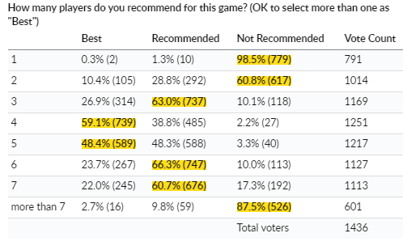
Example: 7 Wonders
For each player count that the game supports (2-7)
Recommended % = 1 – (Not Recommended %)
SD(0.39,0.9,0.98,0.97,0.9,0.82) = 0.2216
Race for the Galaxy | 0.96|0.96|0.94 | 0.011547 | 3147
Dominion | 0.94|0.99|0.93 | 0.0321455 | 5437
Catan | 0.93|0.98 | 0.0353553 | 4219
Pandemic | 0.9|0.98|0.97 | 0.043589 | 4503
Small World | 0.74|0.96|0.98|0.88 | 0.1089342 | 3227
Agricola | 0.71|0.89|0.98|0.98|0.82 | 0.1145862 | 7070
Ticket to Ride | 0.71|0.95|0.98|0.94 | 0.124499 | 3285
Carcassonne | 0.94|0.98|0.91|0.64 | 0.1543535 | 6990
Puerto Rico | 0.53|0.95|1|0.89 | 0.2131314 | 5222
7 Wonders | 0.39|0.9|0.98|0.97|0.9|0.82 | 0.2216002 | 8463

Slide 33
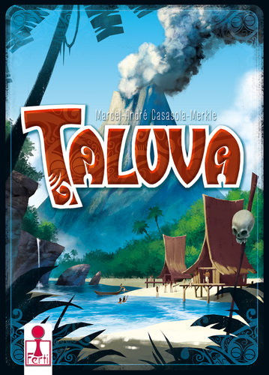

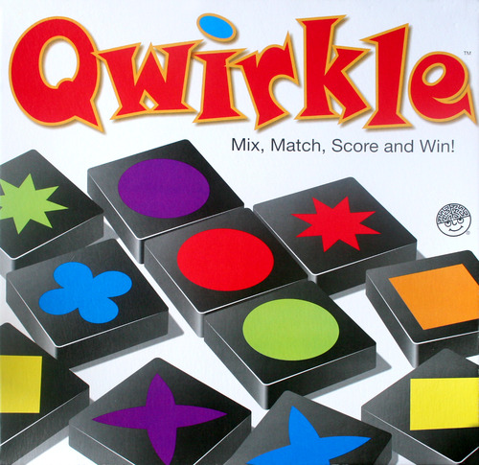
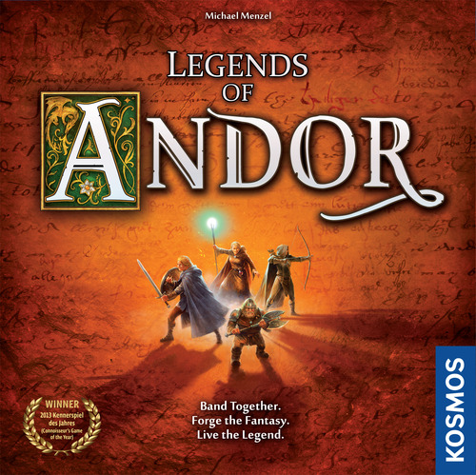

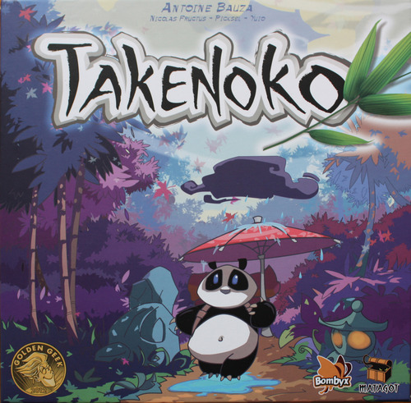

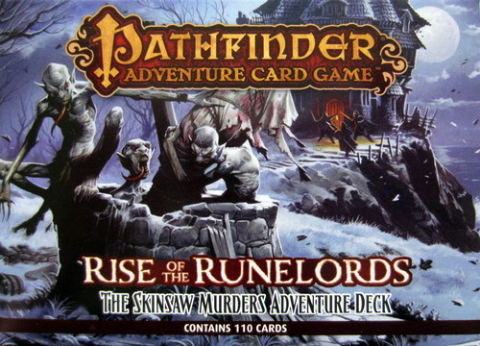
Most Balanced Games (> 500 votes)
411597
Race for the Galaxy | 0.96|0.96|0.94 | 0.011547 | 3147
Taluva | 0.92|0.93|0.9 | 0.0152753 | 534
Qwirkle | 0.96|0.98|0.94 | 0.02 | 509
Legends of Andor | 0.93|0.95|0.97 | 0.02 | 579
San Juan | 0.93|0.98|0.93 | 0.0288675 | 1073
Dominion: Intrigue | 0.95|0.99|0.93 | 0.0305505 | 1018
Dominion | 0.94|0.99|0.93 | 0.0321455 | 5437
Takenoko | 0.94|0.99|0.93 | 0.0321455 | 824
Pathfinder Adventure Card Game: Rise of the Runelords – Base Set | 0.91|0.98|0.98|0.95 | 0.0331663 | 816
Splendor | 0.92|0.98|0.92 | 0.034641 | 1695
Catan | 0.93|0.98 | 0.0353553 | 4219
0.0152
0.0115
0.020
0.020
0.0288
0.0321
0.0346
0.0321
0.0331
0.0353

Slide 34
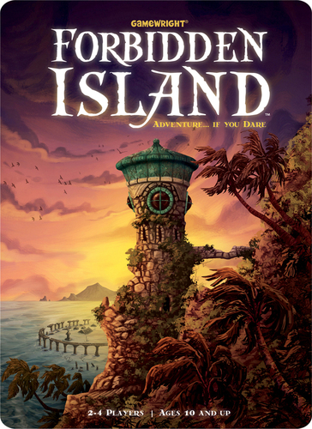
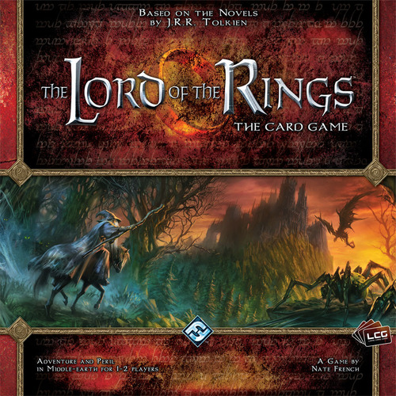
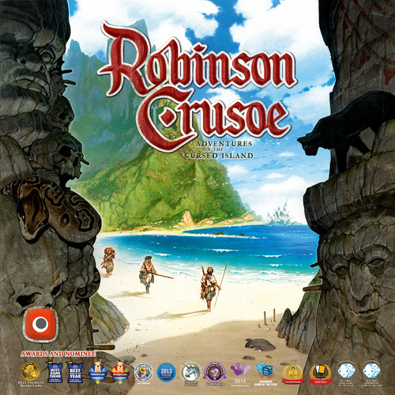
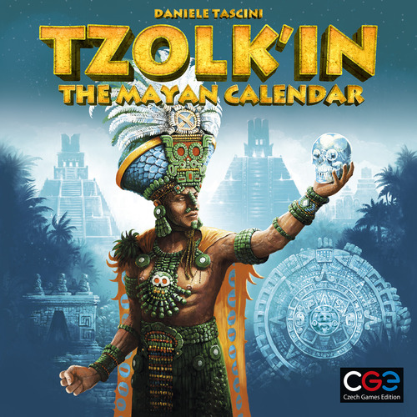
Most Balanced Games (> 1000 votes)
Race for the Galaxy | 0.96|0.96|0.94 | 0.011547 | 3147
San Juan | 0.93|0.98|0.93 | 0.0288675 | 1073
Dominion: Intrigue | 0.95|0.99|0.93 | 0.0305505 | 1018
Dominion | 0.94|0.99|0.93 | 0.0321455 | 5437
Splendor | 0.92|0.98|0.92 | 0.034641 | 1695
Catan | 0.93|0.98 | 0.0353553 | 4219
Robinson Crusoe: Adventures on the Cursed Island | 0.94|0.98|0.97|0.9 | 0.0359398 | 1567
Tzolk'in: The Mayan Calendar | 0.9|0.97|0.96 | 0.0378594 | 1001
Pandemic | 0.9|0.98|0.97 | 0.043589 | 4503
Forbidden Island | 0.92|1|0.99 | 0.043589 | 1176
The Lord of the Rings: The Card Game | 0.92|0.99 | 0.0494975 | 1275
0.0346
0.0321
0.0353
0.0115
0.0288
0.0359
0.049
0.0378
0.0435
0.0435

Slide 35
Most Balanced Games (> 3000 votes)
Race for the Galaxy | 0.96|0.96|0.94 | 0.011547 | 3147
Dominion | 0.94|0.99|0.93 | 0.0321455 | 5437
Catan | 0.93|0.98 | 0.0353553 | 4219
Pandemic | 0.9|0.98|0.97 | 0.043589 | 4503
Small World | 0.74|0.96|0.98|0.88 | 0.1089342 | 3227
Agricola | 0.71|0.89|0.98|0.98|0.82 | 0.1145862 | 7070
Ticket to Ride | 0.71|0.95|0.98|0.94 | 0.124499 | 3285
Carcassonne | 0.94|0.98|0.91|0.64 | 0.1543535 | 6990
Puerto Rico | 0.53|0.95|1|0.89 | 0.2131314 | 5222
7 Wonders | 0.39|0.9|0.98|0.97|0.9|0.82 | 0.2216002 | 8463
0.0115
0.0321
0.0435
0.108
0.0353
0.114
0.213
0.124
0.154
0.221
Notes:
Caveat: this method does not take into account custom rule variants that make games better for certain player counts, since all im doing is pulling data

Slide 36
Final Thoughts
Despite your childhood memories: there are no *bad* games
Board games are booming
Never been a better time to get into board games
BoardGameGeek offers a lavish amount of data for investigation

Slide 37
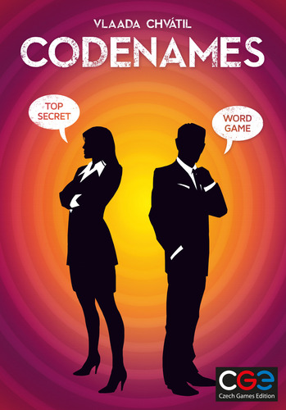


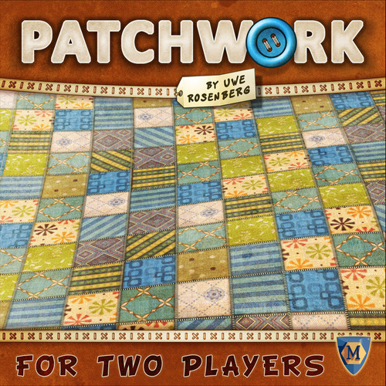
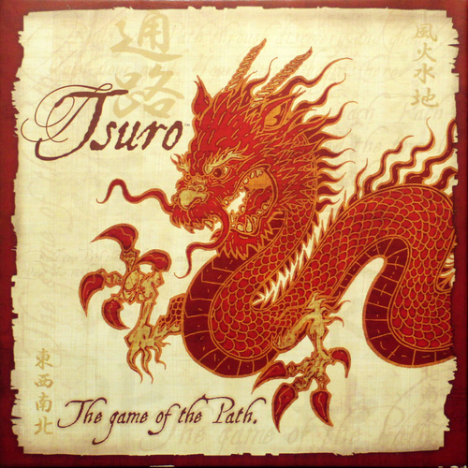

Find Some Fun!
Not sure where to start? Find a game at PAX this weekend!
Tabletop Tourneys
Splendor at 4pm, Love Letter at 6pm – Olive 8
Games in the freeplay area – WSCC Level 2
My recommends to try:

Slide 38
Resources for self-study
source code, deck, raw data:
https://github.com/scottburger/pax17
More in-depth code: svburger.com
https://www.boardgamegeek.com/xmlapi2

